Slide 1

HEART DISEASE PREDICTION USING MACHINE LEARNING
Batch - A6
D NAGA PHANINDRA Y19AIT428
G RAMYA Y19AIT441
A LAKSHMI PRASANNA Y19AIT403
D BEAULA RANI Y19AIT425
Guided by
SHAIK MABASHA, M Tech
Asst Professor, IT Department

Slide 2
ABSTRACT
Heart-related diseases or cardiovascular diseases (CVDs) are the major reason for a huge number of deaths in the last few decades. Many researchers, in recent times, have been using several machine learning techniques to help the health care industry and professionals in the diagnosis of heart-related diseases. Some of the data mining and machine learning techniques such as Random Forest, and Support Vector Machine (SVM), Neural Network are used to predict heart diseases, The main objective of this research project is to predict a patient’s heart disease using machine learning algorithms.

Slide 3
INTRODUCTION
Heart is an important organ of the human body. It pumps blood to every part of our anatomy.
Changes in lifestyle, work-related stress, and bad food habits contribute to the increase in the rate of several heart-related diseases.
Heart diseases killed 1.7 million Indians in 2016, according to the 2016 Global Burden of Disease Report, released on September 15, 2017.
According to World Health Organization, heart-related diseases are responsible for taking 17.7 million lives every year, 31% of all global deaths.
Estimates made by the World Health Organization (WHO), suggest that India has lost up to $237 billion, from 2005- 2015, due to heart-related diseases.
Medical organizations, all around the world, collect data on various health-related issues, and the data is very massive and noisy, which is too hard for analyzing with human brains, and can be easily explored using various machine learning techniques.
ML offers an opportunity to improve accuracy by exploiting complex interactions between risk factors.
Thus, these algorithms have become very useful, in recent times, to predict the presence or absence of heart-related diseases accurately.

Slide 4
EXISTING SYSTEM
Chalabeyene and others recommended Prediction and Analysis of the occurrence of Heart Disease Using Data Mining Techniques.
Dataset is computed using WEKA software.
Senthilkumar Mohan et al, implemented hybrid machine learning for heart disease prediction.
Used dataset – Cleveland.
They have proposed their own Hybrid Random Forest Linear Method (HRFLM).
Ali, Liaqat, et al, propose a system containing two models based on linear Support Vector Machine (SVM).
Used dataset – Cleveland.
They have obtained an improvement in accuracy over conventional SVM models by 3.3%. on of Random Forest (RF) and Linear method (LM).

Slide 5
Singh, Yeshvendra K. et al, deal with various supervised machine learning algorithms such as Random Forest, Support Vector Machine, Logistic Regression, Linear Regression, and Decision Tree with 3-fold, 5-fold, and 10-fold cross-validation techniques.
Used dataset – Cleveland.
Linear Regression - 83.82%
Logistic regression - 83.83%
Support Vector Machine - 79.12%
Decision tree 79.54%
Random forest - 85.81%

Slide 6
PROPOSED SYSTEM
This project aims to know whether the patient has heart disease or not.
The records in the dataset are divided into the training set and test sets.
The training set will be given to the model for training the model and the testing set will be given to test the model.
Initially the data is preprocessed so it will be given to the models.
After preprocessing the data, the data classification technique namely support vector machine, artificial neural network, and random forest were applied to predict whether the patient has heart disease or not.
If the models predict that the patient has heart disease, then we recommend him/her take the necessary treatment.
If the patient doesn’t have heart disease, then we will inform the patient about the results and recommend they take care of their health.

Slide 7
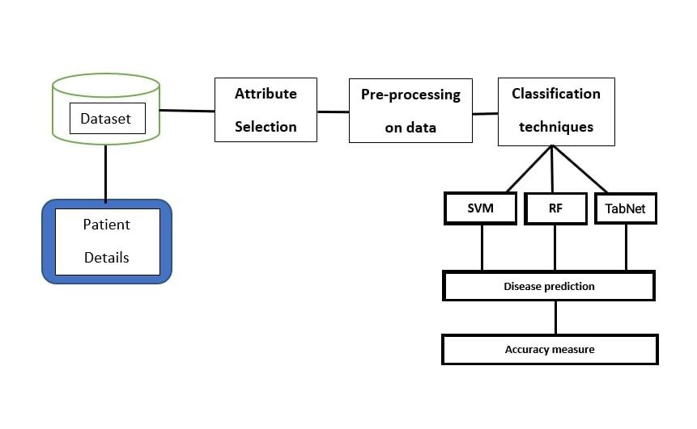
PROPOSED SYSTEM

Slide 8
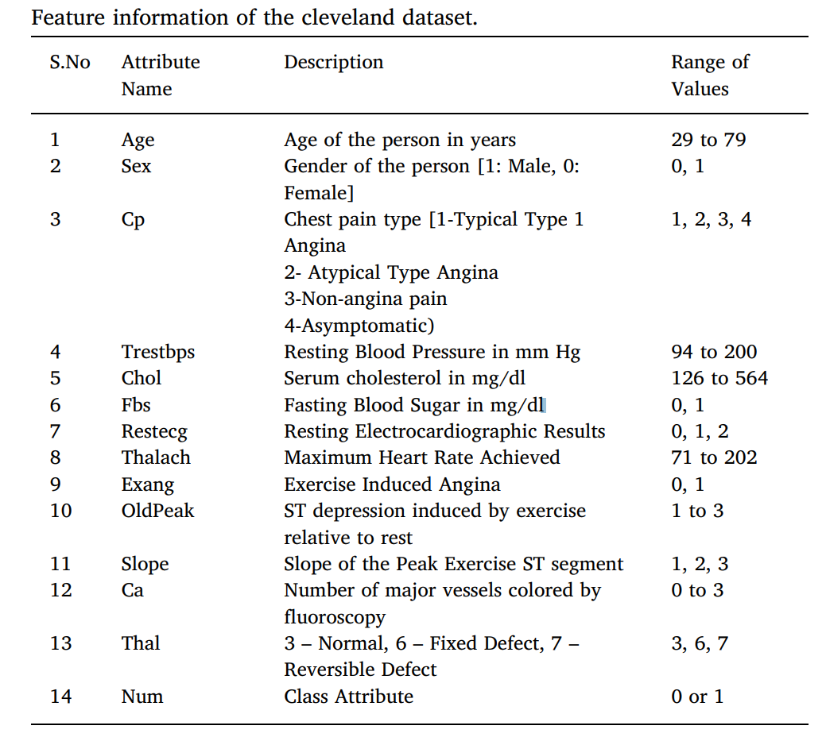
Cleveland dataset
The Cleveland heart dataset from the UCI Machine learning repository has been used for the experiments.
Initially we have taken 295 records dataset.
Then changed to the dataset consists of 14 attributes and 1052 records.
There are 8 categorical attributes and 6 numeric attributes.
The description of the dataset is shown in the table.
URL of the dataset: https://www.kaggle.com/datasets/johnsmith88/heart-disease-dataset

Slide 9
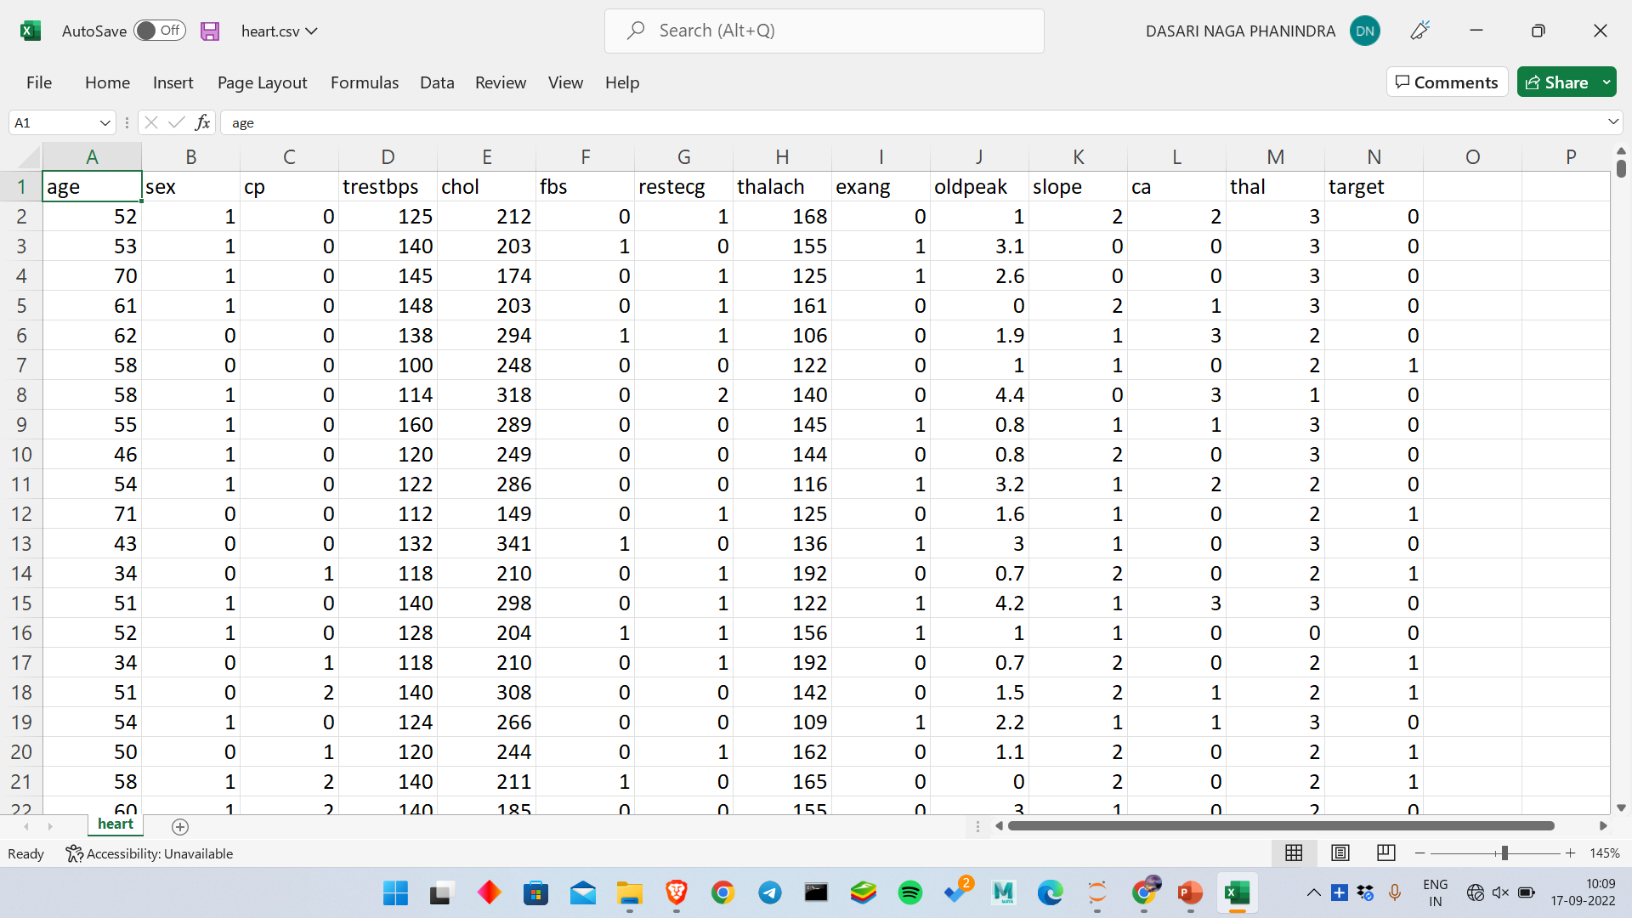

Slide 10
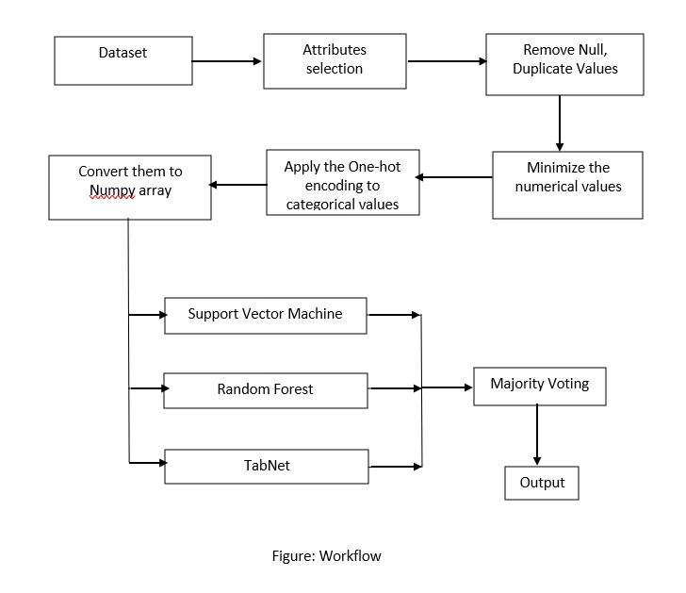
WORKFLOW
The data values are collected from the dataset.
Check for the null values, if any exist then remove those null values.
If a column has more than 50% null values then remove that column.
We have used the Standardscaler method to minimize the numerical values.
Then we applied the one-hot encoding to categorical values.
Then convert them into a NumPy array in order to give to our model.
Then we pass the pre-processed data to our models and predict the output.
Based on the majority voting of the output we will specify whether the patient has heart disease or not.

Slide 11
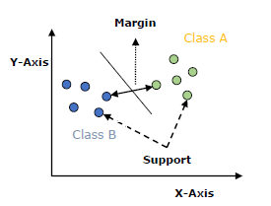
METHODOLOGY
Support Vector Machine(SVM)
Support Vector Machine or SVM is one of the most popular Supervised Learning algorithms, which is used for Classification as well as Regression problems. However, primarily, it is used for Classification problems in Machine Learning.
The goal of the SVM algorithm is to create the best line or decision boundary that can separate n-dimensional space into classes so that we can easily put the new data point in the correct category in the future. This best decision boundary is called a hyperplane.
SVM chooses the extreme points/vectors that help in creating the hyperplane. These extreme cases are called support vectors, and hence algorithm is termed as Support Vector Machine. Consider the below diagram in which there are two different categories that are classified using a decision boundary or hyperplane

Slide 12
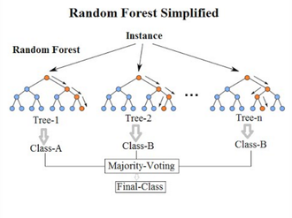
RANDOM FOREST
Random Forest is a classifier that contains several decision trees on various subsets of the given dataset and takes the average to improve the predictive accuracy of that dataset. Instead of relying on one decision tree, the random forest takes the prediction from each tree and based on the majority votes of predictions, it predicts the final output. The greater number of trees in the forest leads to higher accuracy and prevents the problem of overfitting.

Slide 13
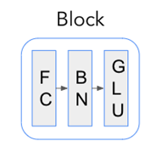
TabNet
TabNet mimics the behavior of decision trees using the idea of Sequential Attention. Simplistically speaking, you can think of it as a multi-step neural network that applies two key operations at each step:
An Attentive Transformer selects the most important features to process at the next step.
A Feature Transformer processes the features into a more useful representation.
The output of the Feature Transformer is later used in the prediction. Using both the Attentive and Feature transformers, TabNet is able to simulate the decision-making process of tree-based models.
Feature Blocks :
Feature Blocks consist of sequentially applied Fully-Connected
(FC) (or Dense) layers and Batch Normalization (BN). In addition,
for Feature Transformers the output gets passed through the GLU
activation layer.

Slide 14
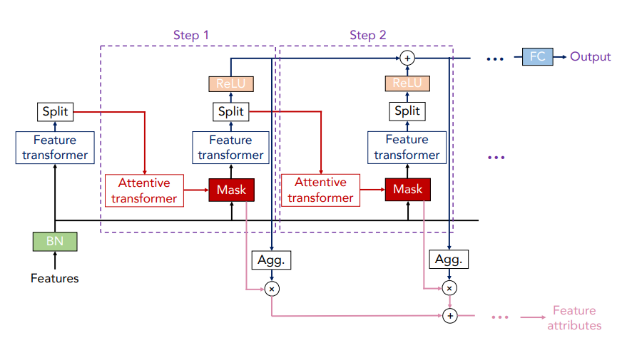
Figure: Structure of TabNet algorithm

Slide 15
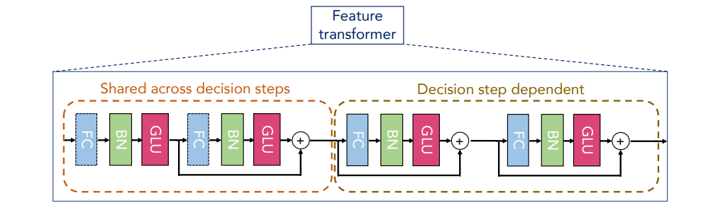
We can see that the Feature transformer layer consists of two parts. The parameters of the first half of the layer are shared, which means that they are jointly trained on all steps; while the second half is not shared and is trained separately on each step. For each step, the input is the same features, so we can use the same layer to do the common part of the feature calculation, and then use different layers to do the feature part of each step.
Figure: Structure of the Feature Transformer layer

Slide 16
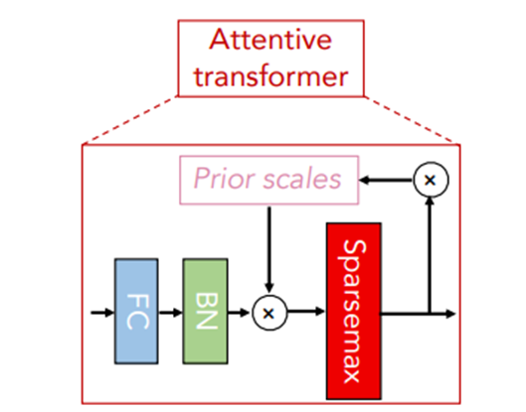
Attentive Transformer:
An attentive transformer consists of a fully connected (FC) layer, a BatchNorm layer, and Prior scales layer, and a Sparsemax layer. After passing through the fully connected layer and Batch normalization layer, it receives input and passes through the prior scales layer.
This prior scale layer aggregates how much each feature has been used before the current decision step.
Sparsemax layer: It is used for normalization of the coefficient (similar to softmax)
Attention Mask:
The output from the attentive transformer step is then fed into the attention mask, which helps identify the selected features.
Figure: Attentive Transformer layer

Slide 17
Performance
Model Name | Accuracy
Support Vector Machine | 84.91 %
Random forest | 92.45 %
TabNet | 86.79 %
The Random forest got the highest accuracy of 92.45% among all the used models, the TabNet got the 2nd place with a maximum of 90.15% accuracy and a minimum of 86.79% accuracy, and finally, the support vector machine got an accuracy of 84.91%.
Conclusion
The final output will be decided by applying the majority voting on the three models. If any of the models predict that the patient had heart disease then the output will be positive(have the heart disease) else the output will be negative(doesn’t have heart disease).

Slide 18
Requirements
Software Requirements:
Operating System: Windows 7 and above
Languages: Python 3.9 & above
IDE : Anaconda Navigator
Hardware Requirements:
Processor: 32 or 64-bit, i3 and above dual-core processor in Windows/ Unix Machine.
Ram: 4GB and Above
Disk Space: Minimum 10 GB disk space for Anaconda

Slide 19
THANK YOU

